Slide 1
User Centered Innovation | UCI | ETM 556/656
Final Presentation
Design a Management Process in a Dairy Company to Convert New Ideas Outside and Inside the Organization into New Products
Professor: William Dresselhaus
Presented By: Farzaneh Noroozi

Slide 2
Innovation Department
define a new Dep. called the innovation Dep. in the system, whose task is to collect all creative ideas from employees and consumers
define the website as the input of innovation
New Product
Collect all Creative Ideas About
Organization Processes
All the Activities that are Done in the Organization
New Business

Slide 3
Each department supposes to bring at least two ideas a year
1- Internal team members Idea
Results from Research & Best Practices Worldwide
2- Taking Idea from consumers
Results from Forming a Focus Group of Consumers & workshops for our loyal customers

Slide 4
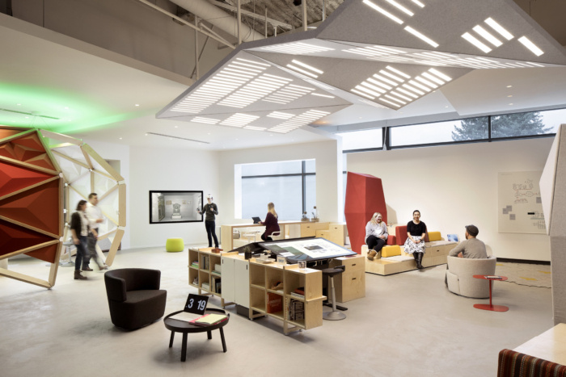
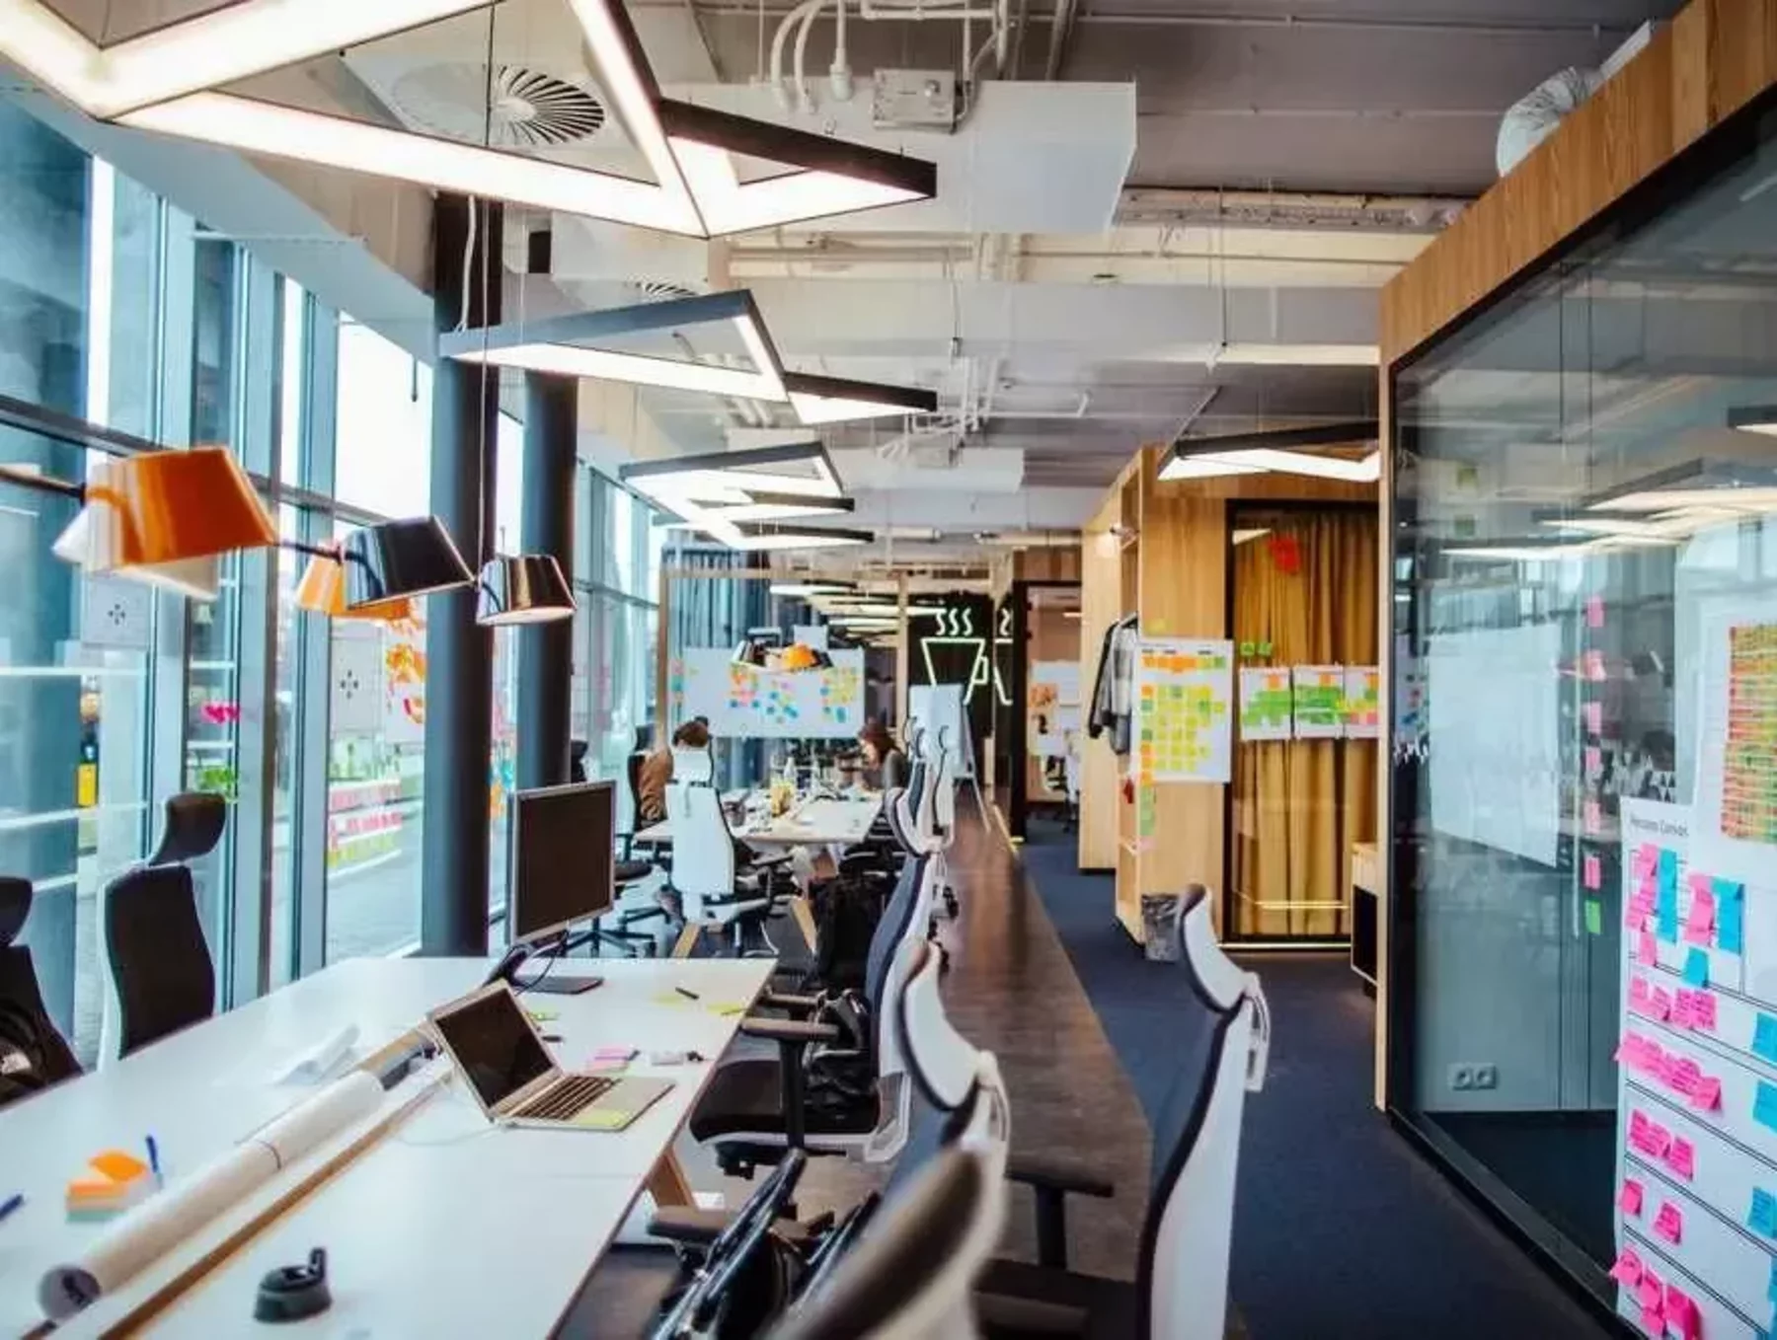
Preparing a room full of equipment and allocating time to generate new ideas is highly recommended

Slide 5
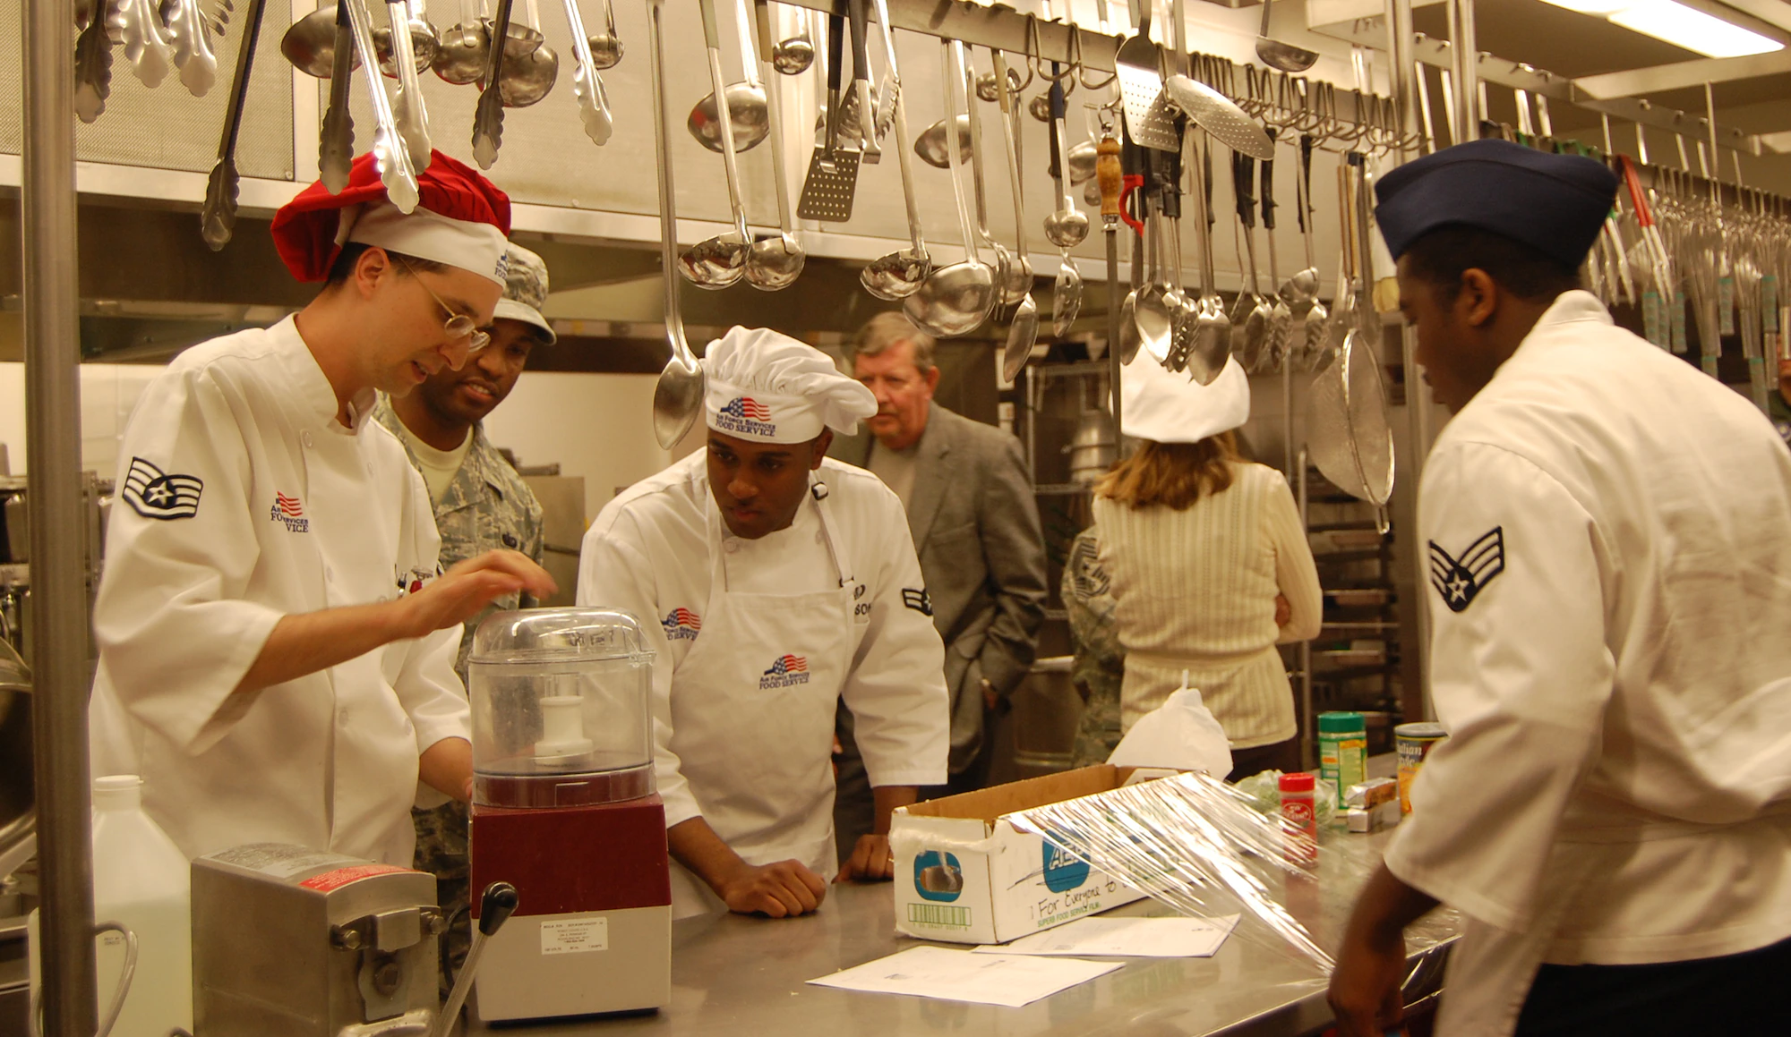
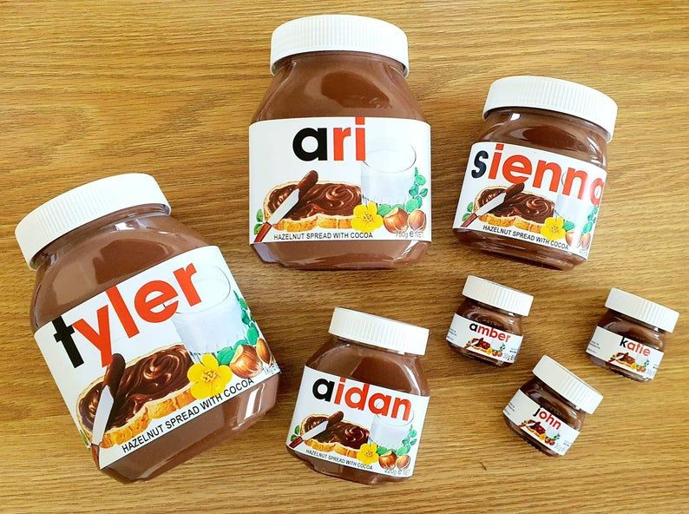
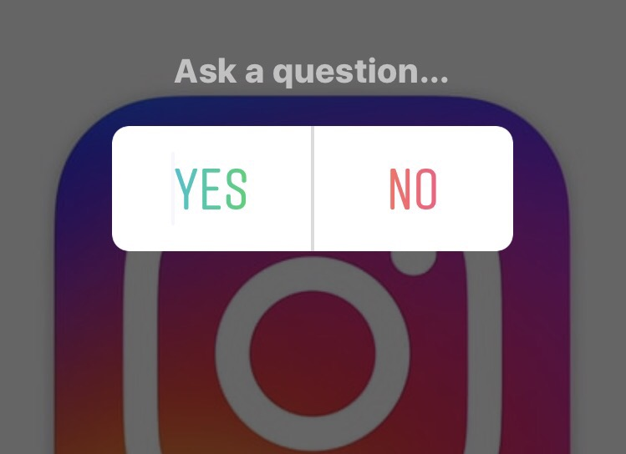
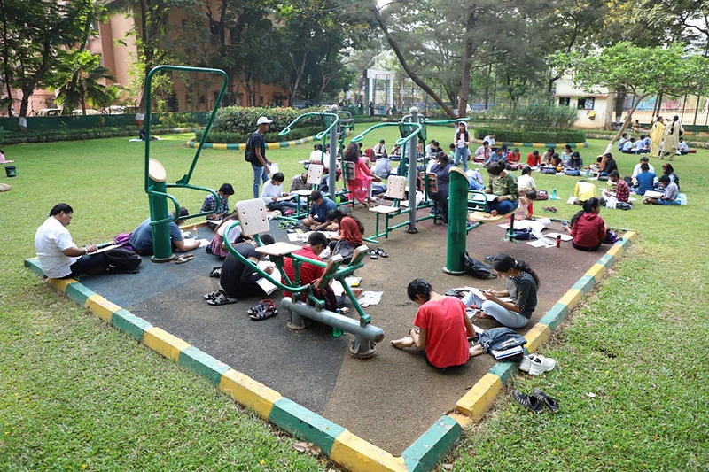
Market Research Tools
Related Department will inform the PMG through meetings or reports
Consumers as R&D specialist and Panelist
Consumers as designers
Consumers as Marketing Specialist
Consumers as Marketing Specialist
Public visit to the factory
Competitions among the participants
Preparing kits of different flavors and spices for each production line
Consumers' names and comments in their preferred packaging shape, size and font
Survey about packaging or taste of new products on social media
Holding competitions in the park and let consumers to design advertising slogan & billboards

Slide 6
Departments Flowchart
New Product
Project Management Group (PMG)
Marketing
Production
R&D
Human resource
Procurement
Engineering
Innovation Department
Weekly collecting data
Giving Ideas to the relevant department

Slide 7
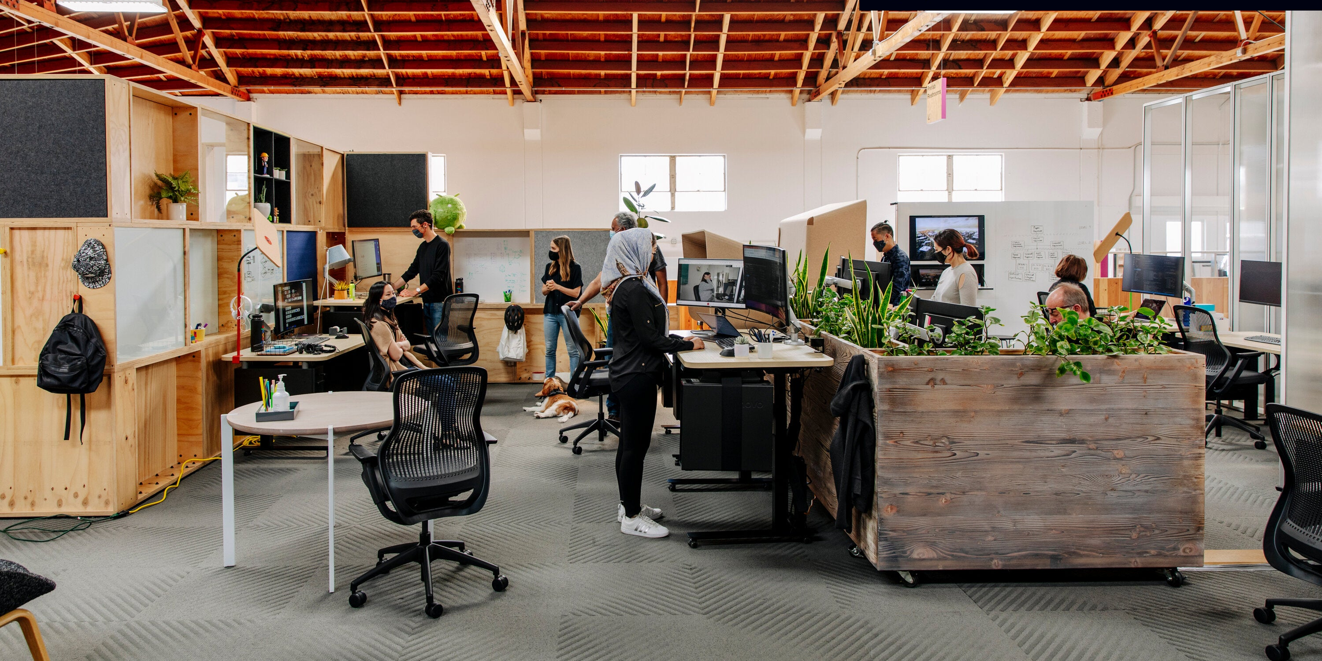
Project Management Group (PMG)
Manage time, cost, risk and communication using tools such as meetings and reports between different departments, consumers and owners of new ideas.
Notes:
As you know, in almost all organizations, the project control group creates a kind of coordination between other departments with special management tools. In this project, the role of this group is to manage time, cost, risk and communication using tools such as meetings and reports between different departments, consumers and owners of new ideas.

Slide 8
Co-Design steps to convert internal and external ideas into new products
R&D Department
R&D
New ideas from consumers and employees from each of the described portals are considered after Production feasibility
We can use information obtained from consumer focus groups and workshops of loyal customers to do the production feasibility
Evaluation of Production with existing Facilities and inform the engineering, procurement and project management departments about needs like machinery, Glasses, raw materials, aluminum foil and ... based on customer feedback
All Machinery and Raw materials needed to implement the idea of consumers are announced after examining the expert opinions of engineering, procurement and project management departments
Consumers
Procurement
PMG
Engineering

Slide 9
Co-Design steps to convert internal and external ideas into new products
Engineering Department
R&D
Design a new production line from consumer’s Ideas and inform PMG & R&D about the possibility of launch a new production line
considering the existing space and facilities what facilities are needed to launch a new line
They will also inform Procurement Department about needs like valves, space, cold storage, machinery, and plumbing for the new production line and prioritizes the input of materials
Consumers
Procurement
PMG
Engineering

Slide 10
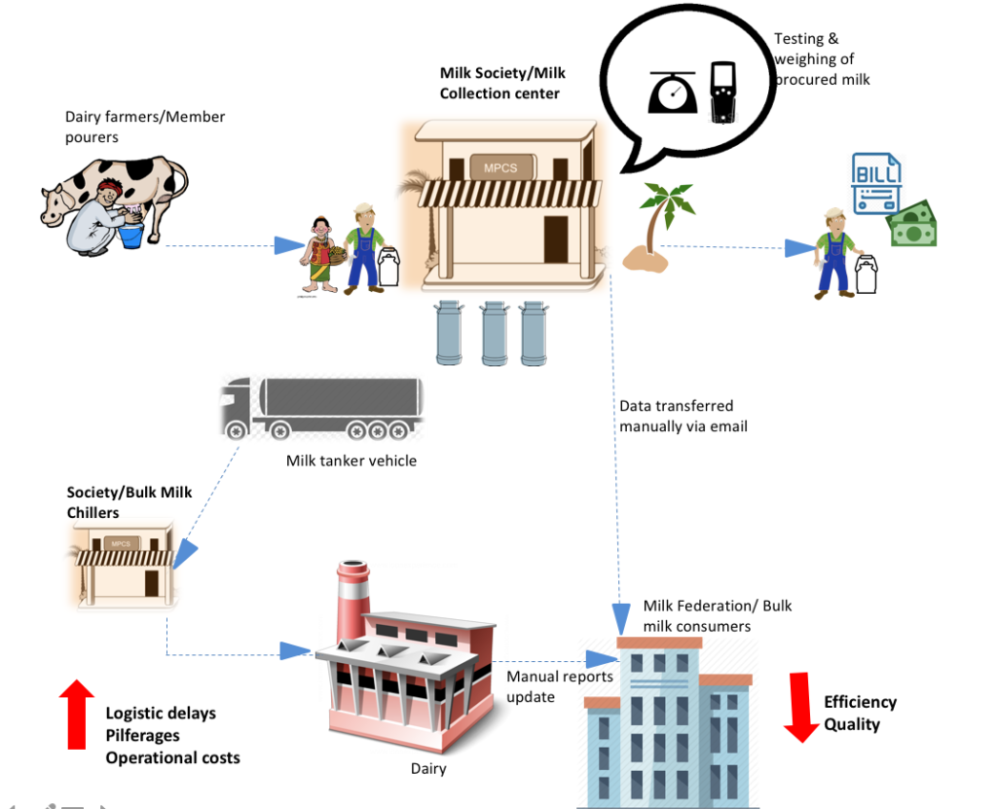
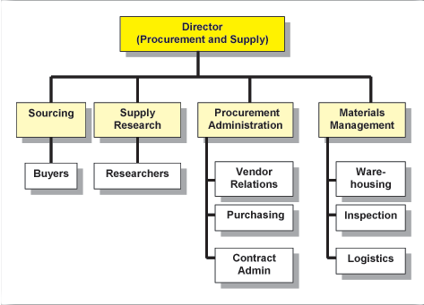
Co-Design steps to convert internal and external ideas into new products
Procurement Department
Use resource management tools like RAM, RACI, and WBS (work break down structure) to provide the necessary equipment for consumers and departments, and prioritizes the input of materials

Slide 11
Co-Design steps to convert internal and external ideas into new products
R&D Department
R&D
Produces the sample product using the ideas of consumers
Conduct test Paneling by employees, consumers and owner of new Ideas
choosing the popular formula between consumers as Final Formula
Cost Estimation
Consumers
Procurement
PMG
Engineering

Slide 12
Co-Design steps to convert internal and external ideas into new products
Product Department
Approval
PMG
Approval
Design group
Using consumers designs for packaging shape, size and font
Marketing Department
Consumers can advertise the product in the market by tools like social media (Giving prizes to those who post or story our ads) or using designed advertising slogan & billboards by consumers
Finally, we can launch a new product that is the result of the idea of consumers or one of the employees

Slide 13
R&D Dep.
Production Feasibility using lessons, and learning, inside or outside the organization
Evaluation of Production with Existing Facilities and inform the engineering, procurement and project control department about needs like machinery, Glasses, raw materials, aluminum foil and ... based on customer feedback
Machinery and Raw materials are announced after examining the expert opinions of engineering, procurement and project control departments
Engineering Dep.
Design a new production line from consumer’s Ideas and inform PMG & R&D about the possibility of launch a new production line and considering the existing space and facilities what facilities are needed to launch a new line
They will also inform Procurement Department about needs like valves, space, cold storage, machinery, and plumbing for the new production line and prioritizes the input of materials
Procurement Dep.
Use resource management tools like RAM, RACI, and WBS (work break down structure) to provide the necessary equipment for consumers and departments, and prioritizes the input of materials
R&D Dep.
Produces the sample product using the ideas of consumers
Conduct test Paneling by employees, consumers and owner of new Ideas
choosing the popular formula between consumers as Final Formula
Cost Estimation
Co-Design steps to convert internal and external ideas into new products
Product Dep.
Approval
PMG
Approval
Design group
Using consumers designs for packaging shape, size and font
Marketing Dep.
Consumers can advertise the product in the market by tools like social media (Giving prizes to those who post or story our ads)
New Production Line

Slide 14
Grow the Company
Tools and Facilities
Increase Revenue & Loyal Customers
Design a Management Process in a Dairy Company
Make a New Product Idea
Customers
Stakeholders
Project Management Group (PMG)
Marketing
Engineering
Procurement
R&D
Production
Human resource
Innovation Department

Slide 15


